Slide 1
Decrease and Conquer
Notes:
To create Em dash above headline:
Same size and weight as the headline and set using a soft return.
PC: Em dash (—): Alt+Ctrl+ - (minus)
Mac: Em dash (—): Shift+Alt/Option+hyphen

Slide 2
Agenda
Overview
Decrease-by-a-constant: Insertion Sort
Decrease-by-a-constant: Topological Sorting
Decrease-by-a-constant-factor Algorithms
Variable-size decrease algorithms & Binary Search Trees
Extra topic: K-d tree
Summary

Slide 3
1. Overview
Notes:
To create Em dash above headline:
Same size and weight as the headline and set using a soft return.
PC: Em dash (—): Alt+Ctrl+ - (minus)
Mac: Em dash (—): Shift+Alt/Option+hyphen

Slide 4
Learning objectives
Understand the Decrease & Conquer approach
Understand and apply:
Decrease-by-a-constant algorithms (Insertion Sort and Topological Sort)
Decrease-by-a-constant-factor algorithms (Binary Search and Fake Coin problem)
Variable-size decrease algorithms (Binary Search Tree, Interpolation Search, and Quick Select)

Slide 5
Ferrying soldiers over a river
A detachment of 25 soldiers must cross a wide and deep river with no bridge in sight. They notice two 12-year-old boys playing in a rowboat by the shore. The boat is so tiny, however, that it can only hold two boys or one soldier.
How can the soldiers get across the river and leave the boys in joint possession of the boat?
How many times does the boat pass from shore to shore?
http://brain-puzzlers.blogspot.com/2012/10/ferrying-soldiers.html

Slide 6
Decrease and Conquer approach
Process:
Reduce a problem instance to a smaller instance of the same problem
Solve the smaller instance
Extend the solution of the smaller instance to obtain the solution to the original instance
Sometimes referred to as the inductive or incremental approach.

Slide 7
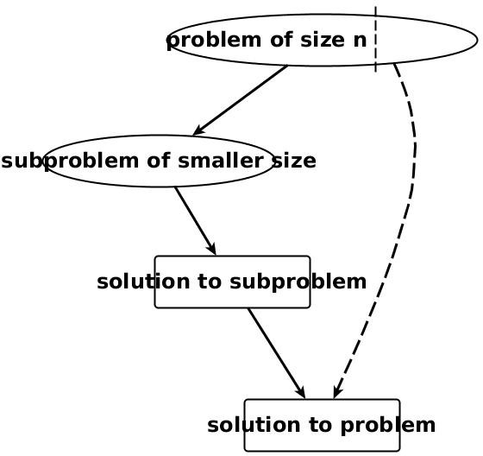
Decrease and Conquer approach

Slide 8
Decrease and Conquer approach
Decrease-by-a-constant
Insertion Sorting
Topological Sorting
Algorithms for generating permutations and subsets
Decrease-by-a-constant-factor
Binary Search
Fake-coin Problem
Multiplication à la russe
Josephus Problem

Slide 9
Decrease and Conquer approach
Variable-size-decrease
Search, Insert and Delete in a Binary Search Tree
Euclid’s Algorithm
Interpolation Search
Quick Select
Game of Nim

Slide 10
Agenda
Overview
Decrease-by-a-constant: Insertion Sort
Decrease-by-a-constant: Topological Sorting
Decrease-by-a-constant-factor Algorithms
Variable-size decrease Algorithms
Extra topic: K-d tree
Summary

Slide 11
1a. Insertion Sort

Slide 12
Insertion Sort – Idea
Consider each element one at a time (left to right).
Insert each element in its proper place among those already considered. (i.e., insert into a already sorted sub-file). This is a right to left scan.
It is a decrease-by-a-constant algorithm
Why? Because every time the array that needs to be sorted the problem gets smaller by one

Slide 13
Insertion Sort
Insertion sort is a simple sorting algorithm that is appropriate for small inputs
Most common sorting technique used by card players
The list is divided into two parts: sorted and unsorted
In each pass, the first element of the unsorted part is picked up, transferred to the sorted sub-list, and inserted at the appropriate place
A list of n elements will take at most n-1 passes to sort the data.

Slide 14
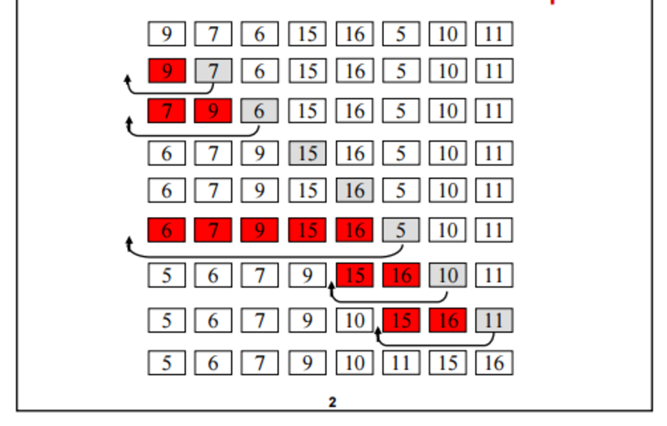
Insertion Sort

Slide 15
Insertion Sort
Sorted
Unsorted
23 | 78 | 45 | 8 | 32 | 56
23 | 78 | 45 | 8 | 32 | 56
23 | 45 | 78 | 8 | 32 | 56
8 | 23 | 45 | 78 | 32 | 56
8 | 23 | 32 | 45 | 78 | 56
8 | 23 | 32 | 45 | 56 | 78
Original List
After pass 1
After pass 2
After pass 3
After pass 4
After pass 5

Slide 16
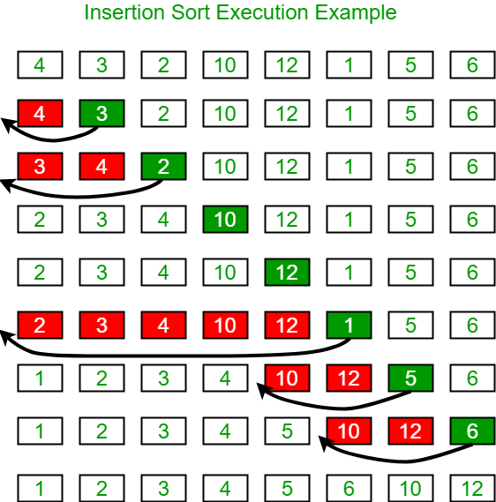
Insertion Sort – Demo
https://visualgo.net/bn/sorting
https://www.geeksforgeeks.org/insertion-sort/

Slide 17
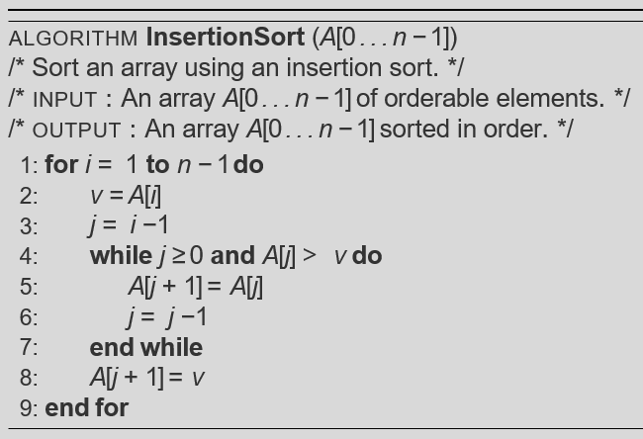
Insertion Sort – Pseudocode
A[j]
v
set the key to be swapped
5 3 4 1
1st pass
3 5 4 1
2nd pass
3 4 5 1
3rd pass
1 3 4 5

Slide 18
Analysis of Insertion Sort
Running time depends on not only the size of the array but also the contents of the array
Best-case:➔ O(n)
Array is already sorted in ascending order
Inner loop will not be executed
The number of moves: 2*(n-1) ➔ O(n)
The number of key comparisons: (n-1) ➔ O(n)
Worst-case: ➔ O(n²)
Array is in reverse order
Inner loop is executed i-1 times, for i = 2,3, …, n
The number of moves: 2*(n-1)+(1+2+...+n-1)= 2*(n-1)+ n*(n-1)/2 ➔ O(n²)
The number of key comparisons: (1+2+...+n-1)= n*(n-1)/2 ➔ O(n²)
Average-case: ➔ O(n²)
We have to look at all possible initial data organizations.
So, Insertion Sort is O(n²)

Slide 19
Analysis of Insertion Sort
Which running time will be used to characterize this algorithm?
Best, worst or average?
Worst:
Longest running time (this is the upper limit for the algorithm)
It is guaranteed that the algorithm will not be worse than this
Sometimes we are interested in average case. However
It is difficult to figure out the average case. i.e. what is average input?
Are we going to assume all possible inputs are equally likely?
In fact for most algorithms average case is same as the worst case.

Slide 20
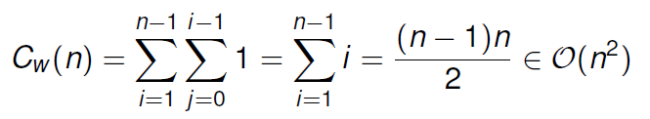
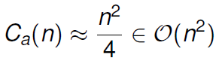
Insertion Sort – Time Complexity
Worst Case: the input is in reverse order
Average Case: For randomly ordered data, we expect each item to move halfway back.
Notes:
The simplest worst case input is an array sorted in reverse order. The set of all worst case inputs consists of all arrays where each element is the smallest or second-smallest of the elements before it. In these cases every iteration of the inner loop will scan and shift the entire sorted subsection of the array before inserting the next element. This gives insertion sort a quadratic running time (i.e., O(n2)).

Slide 21
Insertion Sort – Time Complexity
Best Case:
In terms of the input, what is the scenario/circumstance where we can achieve the best case?
What is the time complexity for the best case?
Is Insertion Sort stable???
Notes:
The best case input is an array that is already sorted. In this case insertion sort has a linear running time (i.e., O(n)). During each iteration, the first remaining element of the input is only compared with the right-most element of the sorted subsection of the array.

Slide 22
Building a better Insertion Sort
Shell’s Sort is a simple but effective extension of insertion sort.
Proposition: For partially-sorted arrays, insertion sort runs in linear time.
What if a fast way can be designed to partially sort an input array?

Slide 23
Shell Sort approach
Apply insertion sort to several interleaving sub-lists of the array.
The sub-lists are formed by stepping through the array with an increment h_{i} which decreases by some predefined increment on each pass, where h₁ > … > h_{i} > . . . > 1.
Choosing the optimal stepping is still an open problem, but the reverse of the sequence 1, 4, 13, 40, 121, 364… i.e., (3x + 1) increment works well in practice
(3*1 + 1) = 4; (3*4 + 1) = 13; (3*13 + 1) = 40…

Slide 24
Shell Sort demo
https://www.cs.usfca.edu/~galles/visualization/ComparisonSort.html

Slide 25
Shell Sort
The worst case number of compares using the 3x + 1 sequence is O(n^{3/2})
The algorithm is not stable
Quite good performance in practice
Notes:
Take home lesson: We don’t know all the answers!

Slide 26
Discussion
An array of size 1000 is randomly populated with integers that range from 1 to 100 (integers are repeated).
Find an O(n) algorithm that sorts the array!

Slide 27
Radix Sort
Radix sort algorithm different than other sorting algorithms so far
It does not use key comparisons to sort an array
The radix sort :
Treats each data item as a character string
First it groups data items according to their rightmost character, and put these groups into order w.r.t. this rightmost character
Then, combine these groups
Repeat these grouping and combining operations for all other character positions in the data items from the rightmost to the leftmost character position (keeping the relative order)
At the end, the sort operation will be completed

Slide 28
Radix Sort – Example
mom, dad, god, fat, bad, cat, mad, pat, bar, him original list
(dad, god, bad, mad) (mom, him) (bar) (fat, cat, pat) group strings by rightmost letter
dad, god, bad, mad, mom, him, bar, fat, cat, pat combine groups
(dad, bad, mad, bar, fat, cat, pat) (him) (god, mom) group strings by middle letter
dad, bad, mad, bar, fat, cat, pat, him, god, mom combine groups
(bad, bar)(cat)(dad)(fat)(god)(him)(mad, mom)(pat) group strings by first letter
bad, bar, cat, dad, fat, god, him, mad, mom, pat combine groups (SORTED)

Slide 29
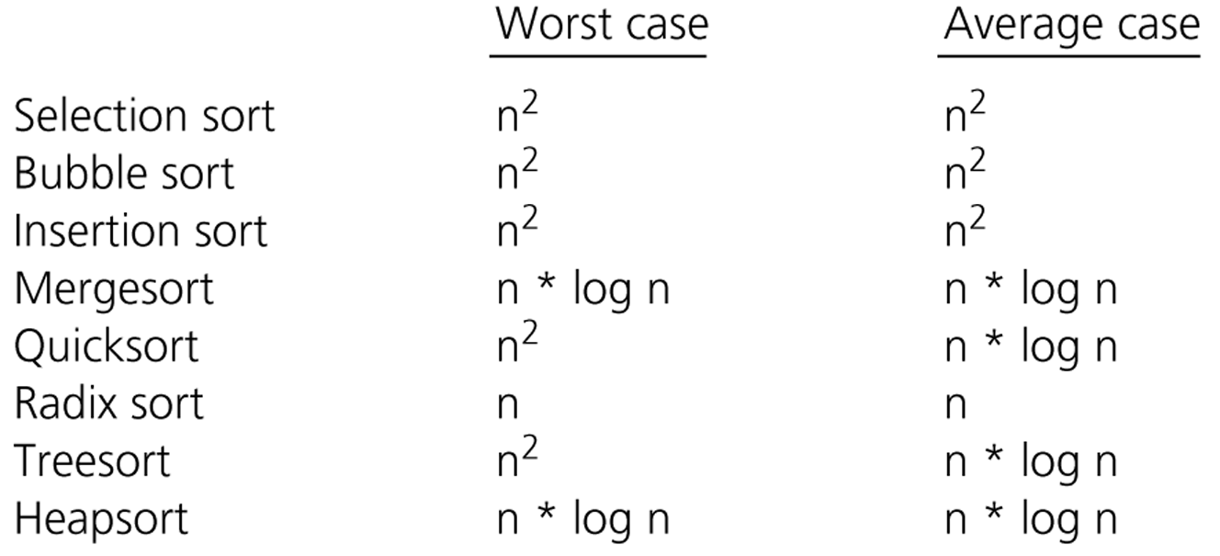
Comparison of Sorting Algorithms

Slide 30
Summary
Insertion sort, bubble sort and selection sort are all O(n²)
In a particular case, one might be better than another. For small problems, insertion sort is a good choice. However, for large problems they all are slow
Quick sort and merge sort are very efficient
The average case for quick sort is O(n*log₂n) and is among the fastest known. However its worst case behavior of O(n²) is significantly slowly than merge sort
Merge sort is not quite as fast as quick sort but its performance is consistently good - O(n*log₂n). Merge sort also has the disadvantage of requiring an extra array

Slide 31
1b. Topological Sorting

Slide 32

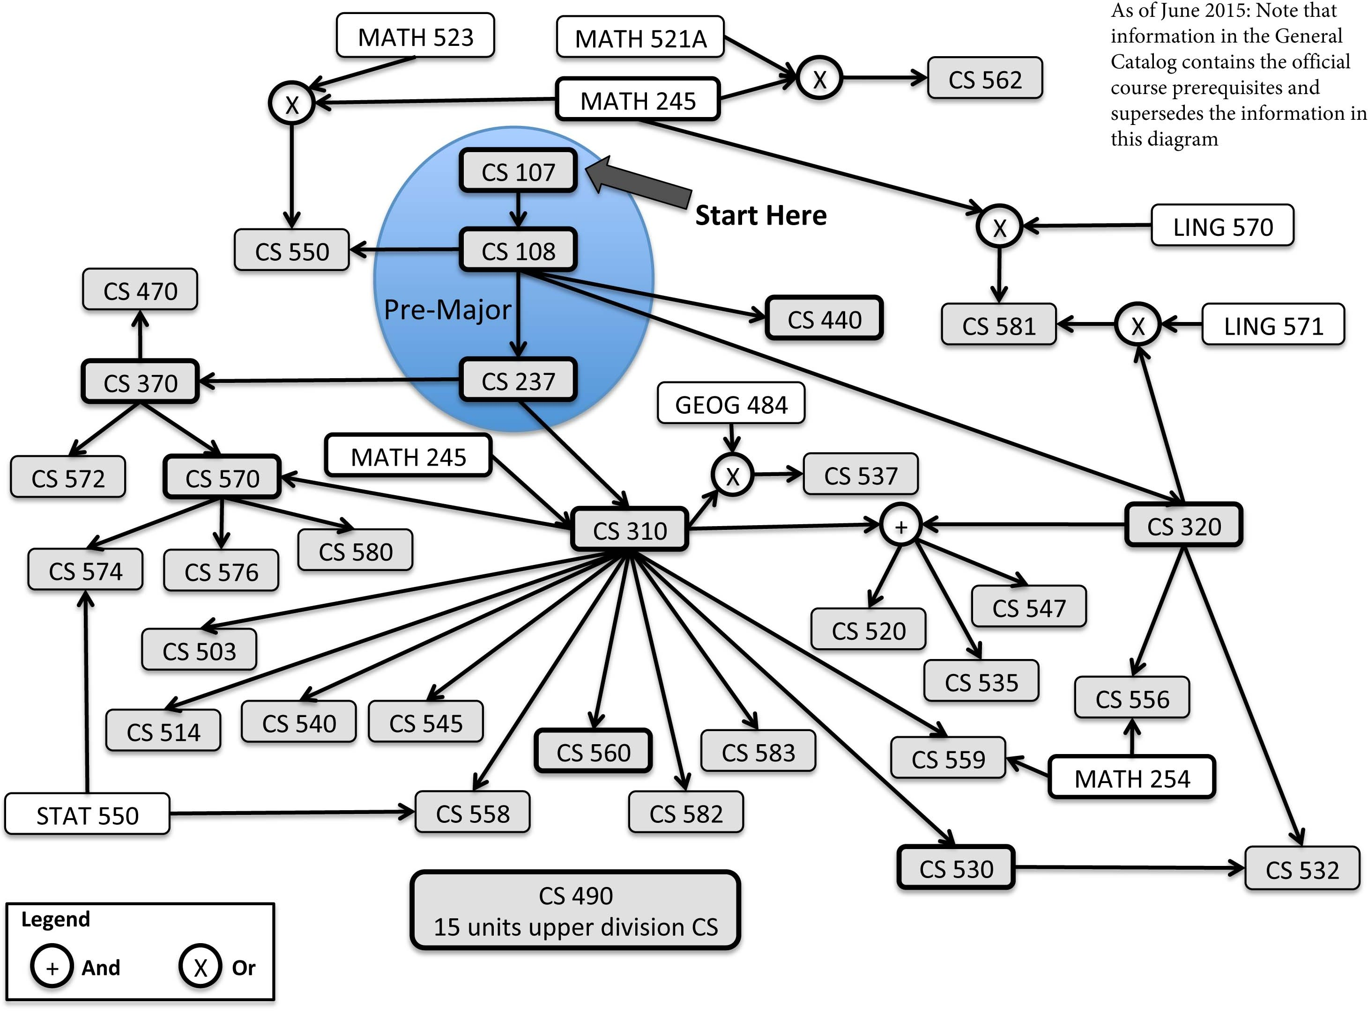
Imagine the following problems
Job scheduling with order dependencies
What is the order the jobs should be processed to avoid breaking these dependencies?
Subject selection
What are the order the subjects could be taken to ensure we have all the pre-requisites?

Slide 33
Topological sort – Approaches
There are two different approaches to solve this problem:
DFS Method
Source Removal Method (focus of this lecture)

Slide 34
Source Removal Method:
Choose a source vertex
A source vertex is the one that has no incoming edges
Delete the vertex and all incident edges and append the vertex to topological ordered list
Repeat the selection of a source vertex and deletion process for the remaining graph until no vertices are left

Slide 35
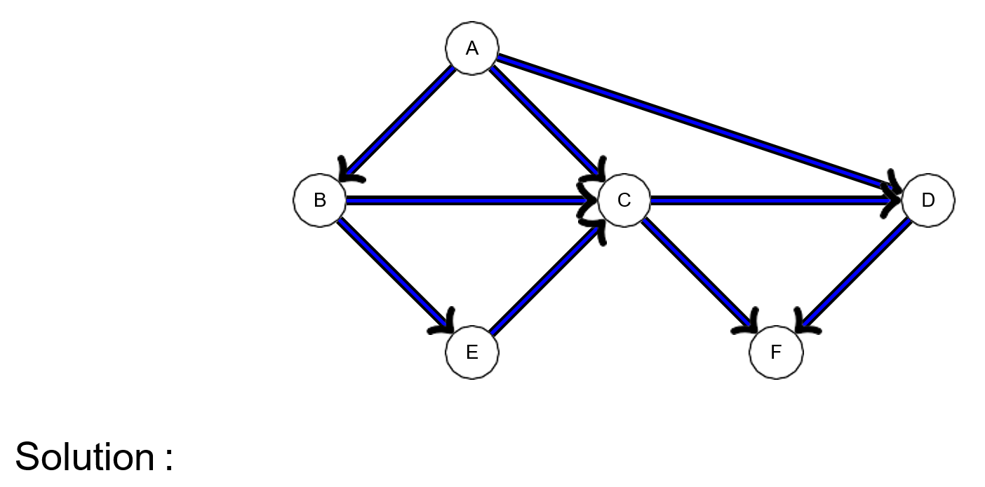
Topological sort – Demo

Slide 36
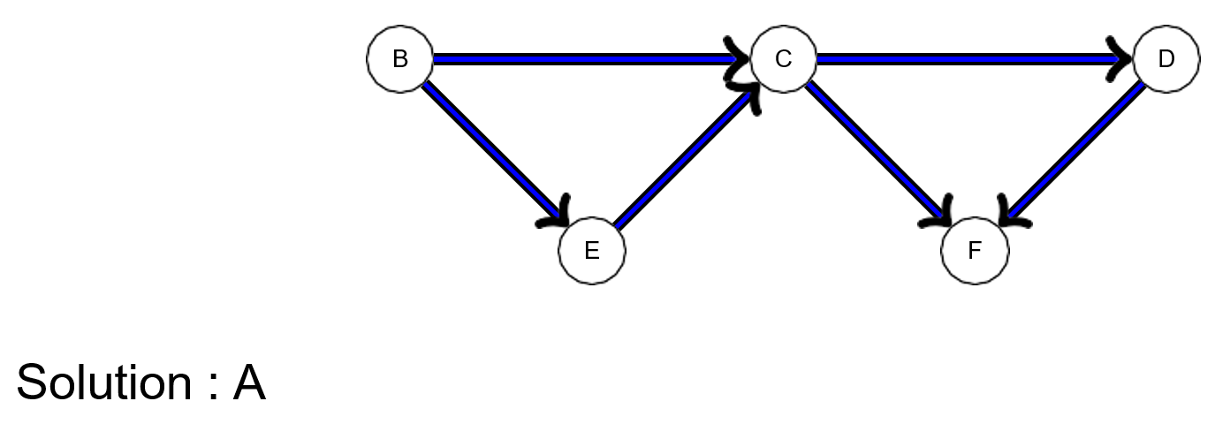
Topological sort – Demo

Slide 37
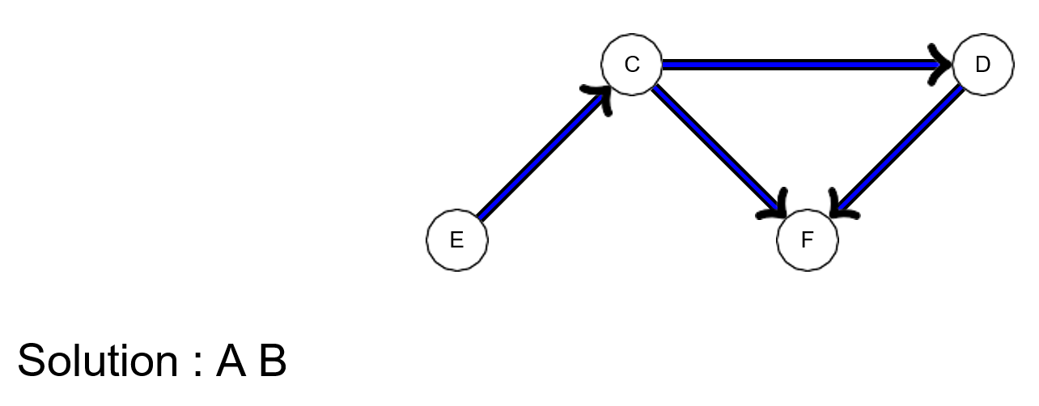
Topological sort – Demo

Slide 38
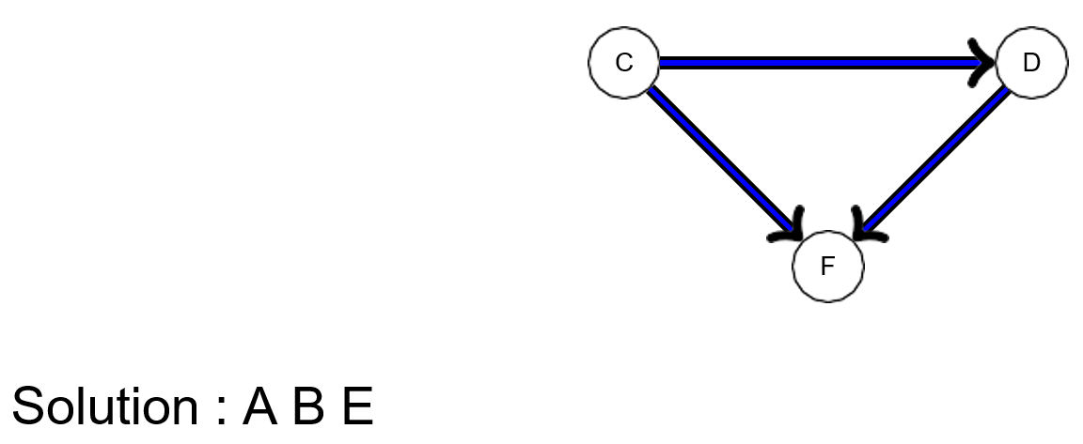
Topological sort – Demo

Slide 39
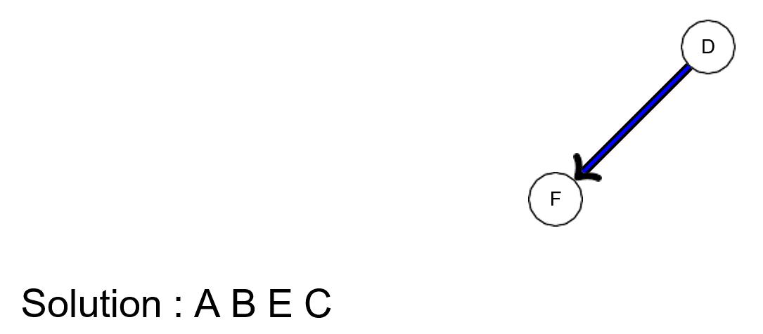
Topological sort – Demo

Slide 40
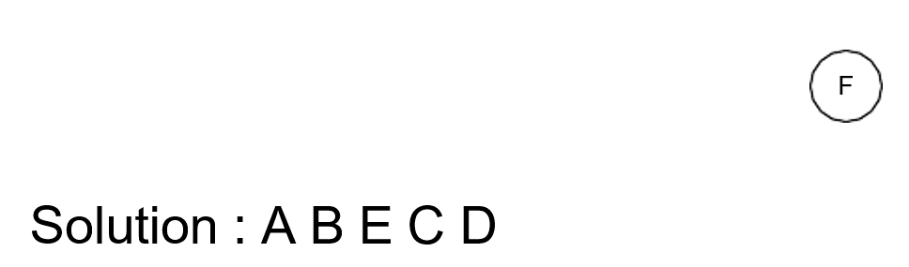
Topological sort – Demo

Slide 41

Topological sort – Demo

Slide 42
Topological sort – Summary
Topological sorting can have more than one solution, and often does for very large DAGs
Source removal algorithm:
How do you find a source (or determine that such a vertex does not exist) in a digraph represented by an adjacency matrix? What is the time efficiency?
How do you find a source (or determine that such a vertex does not exist) in a digraph represented by an adjacency list? What is the time efficiency?

Slide 43
2. Decrease-by-a-constant-factor algorithms

Slide 44
Decrease-by-a-constant-factor Approaches
Algorithms that use this approach divide the problem into parts (half, thirds, etc), and then recursively operate on one of the halves, thirds etc.
Hence, at each iteration, we decrease the problem by a constant factor (a half, a third etc).
We study two examples:
Binary search
Fake coin problem

Slide 45
Binary search
Binary search is a worst-case optimal algorithm for searching in a sorted sequence of elements.
Given a sorted sequence, compare the value in the array at position n/2 with a key k .
If A[n/2] > k , compare k with the midpoint of the lower half.
If A[n/2] < k , compare k with the midpoint of the upper half.
If A[n/2] = k , return n/2 (the index of the position of k ).

Slide 46
Binary search – Demo
Partially sorted
1 | 3 | 5 | 9 | 12 | 24 | 29 | 34 | 35 | 37 | 53 | 62 | 74 | 53 | 62 | 74 | 92
BINARY SEARCH(5)

Slide 47
Binary search – Demo
k should be in this region
A[n/2]
> 5 (k)
1 | 3 | 5 | 9 | 12 | 24 | 29 | 34 | 35 | 37 | 53 | 62 | 74 | 53 | 62 | 74 | 92
BINARY SEARCH(5)

Slide 48
Binary search – Demo
A[n/2] > 5 (k)
1 | 3 | 5 | 9 | 12 | 24 | 29 | 34 | 35 | 37 | 53 | 62 | 74 | 53 | 62 | 74 | 92
BINARY SEARCH(5)

Slide 49
Binary search – Demo
A[n/2] < 5 (k)
1 | 3 | 5 | 9 | 12 | 24 | 29 | 34 | 35 | 37 | 53 | 62 | 74 | 53 | 62 | 74 | 92
K should be on the left…
BINARY SEARCH(5)
Oh wait, it’s there ☺

Slide 50
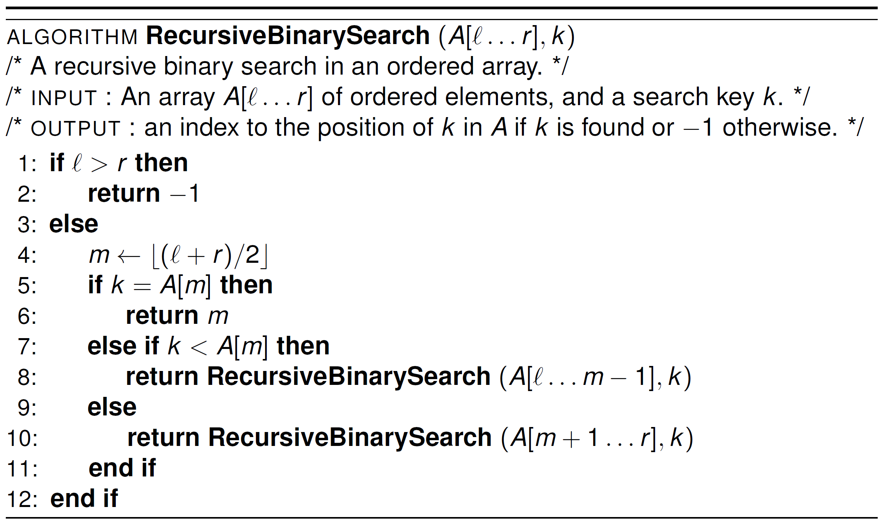
Binary search – Recursive
termination
recurrence

Slide 51
Binary search – Time complexity
C(n) = C([n/2]) + 1 for n > 1 and C(1) = 1
Using the smoothness rule, n = 2^{k}
C(2^{k}) = C(2^{k-1}) + 1 for k > 0, C(2⁰)= C(1) = 1
Substitute C(2^{k-1}) = C(2^{k-2}) + 1
C(2^{k}) = [C(2^{k-2}) + 1] + 1 = C(2^{k-2}) + 2
Substitute C(2^{k-3}) = C(2^{k-3}) + 1
C(2^{k}) = [C(2^{k-3}) + 1] + 2 = C(2^{k-3}) + 3
We see the pattern C(2^{k}) = C(2^{k – i}) + i emerge

Slide 52
Binary search – Time complexity
We see the pattern C(2^{k}) = C(2^{k – i}) + i emerge
C(2^{k}) = C(2^{k – i}) + i
We want C(2^{k – i}) = C(2⁰), or (k − i) = 0 or i = k
C(2^{k}) = [C(2^{k - k}) + k] = [C(2⁰) + k] = [1 + k]
If n = 2^{k} then k = log2n
C(n) = log2n + 1 ∈ O(logn)

Slide 53
Binary search – Time complexity
Worst case of O(log(n)) is only achieved if:
Array is sorted
The array has O(1) access to any position

Slide 54


Fake coin problem
Given a stack of n identical-looking coins which contains exactly one fake coin (which is lighter) and a scale/weigh, devise an efficient algorithm for detecting the fake coin.

Slide 55
Solving fake coin problem
The solution is to use a decrease-by-half algorithm:
Divide into two sub-stacks of n/2 coins and weigh on scale
The lighter sub-stack contains the fake coin
Repeat process with the lighter sub-stack until we have two coins remaining. The fake coin must be one of the two.

Slide 56
Solving fake coin problem
The recurrence relation for number of weighing-s:
C(n) = C([n/2]) + 1 for n > 1, C(1) = 0
Gives worst case of O(logn).

Slide 57
Solving fake coin problem
The recurrence relation for number of weighing-s:
C(n) = C([n/2]) + 1 for n > 1, C(1) = 0
Gives worst case of O(logn).

Slide 58
Solving fake coin problem
https://www.youtube.com/watch?v=wVPCT1VjySA

Slide 59
3. Variable-size decrease algorithms

Slide 60
Interpolation Search
Can be considered an “improved” version of Binary Search
Imagine that we can go even faster than O(logn)!
We can exploit additional knowledge of our values, i.e., use more than just comparisons

Slide 61
Interpolation Search
Interpolation Search: estimate where the search key is based on the collection’s distribution
Simple: use max and min values and assume equal distribution
More advanced: approximation of real distribution (e.g., histograms)

Slide 62
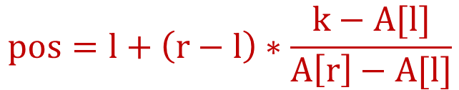
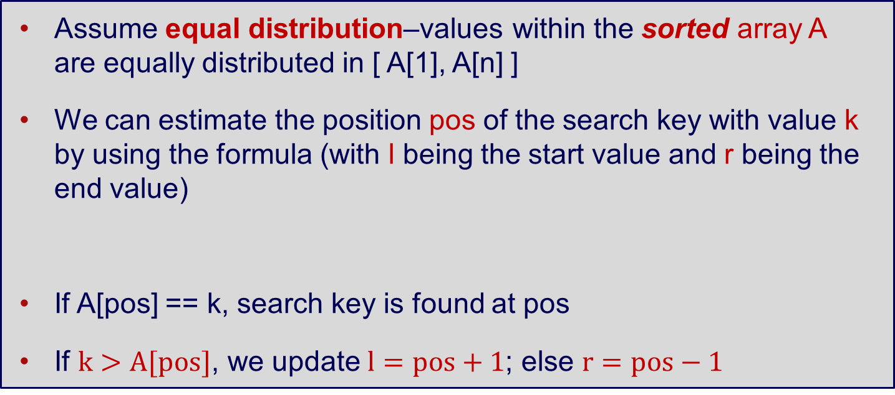
Simple Interpolation Search – Idea
Assume equal distribution–values within the sorted array A are equally distributed in [ A[1], A[n] ]
We can estimate the position pos of the search key with value k by using the formula (with l being the start value and r being the end value)
If A[pos] == k, search key is found at pos
If $k>A[pos]$, we update $l=pos+1$; else $r=pos−1$
$$pos=l+\left(r−l\right)∗\frac{k−A[l]}{A\left[r\right]−A[l]}$$

Slide 63
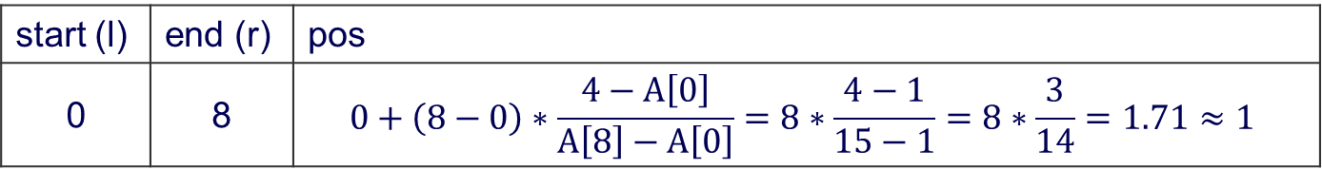
Interpolation Search – Demo
1 | 2 | 4 | 6 | 7 | 10 | 11 | 14 | 15
0 | 1 | 2 | 3 | 4 | 5 | 6 | 7 | 8
start (l)
pos=1
end (r)
k = 4
> A[pos] (2)
start (l) | end (r) | pos
0 | 8 | $$0+\left(8−0\right)∗\frac{4−A\left[0\right]}{A\left[8\right]−A\left[0\right]}=8∗\frac{4−1}{15−1}=8∗\frac{3}{14}=1.71≈1$$

Slide 64
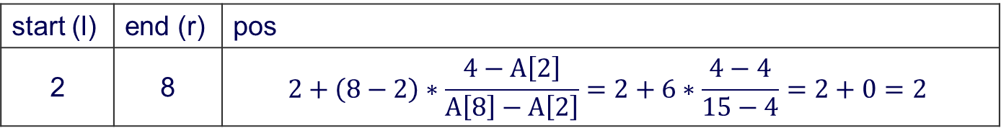
Interpolation Search – Demo
pos=2
1 | 2 | 4 | 6 | 7 | 10 | 11 | 14 | 15
0 | 1 | 2 | 3 | 4 | 5 | 6 | 7 | 8
start (l)
end (r)
k = 4
start (l) | end (r) | pos
2 | 8 | $$2+\left(8−2\right)∗\frac{4−A\left[2\right]}{A\left[8\right]−A\left[2\right]}=2+6∗\frac{4−4}{15−4}=2+0=2$$
Notes:
pos < key (1 < 4)

Slide 65
Interpolation Search – Analysis
Average case: Interpolation Search on equally distributed data requires O(log(log(n)) comparisons
Worse case: O(n), e.g., A is large and contains only values larger than the search key value

Slide 66
Quick Select
Quick Select or Quick Search–adopts the idea of Quick Sort to search for a value
Choose a pivot
Partition the array
Instead of recursing for both sides, we just recur only for the part that contains the k-th smallest element
If k < pivot, recur for the left; else recur for the right

Slide 67
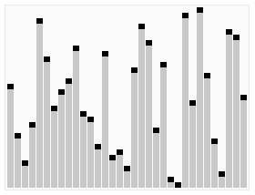
Quick Select – Demo
https://en.wikipedia.org/wiki/Quickselect

Slide 68
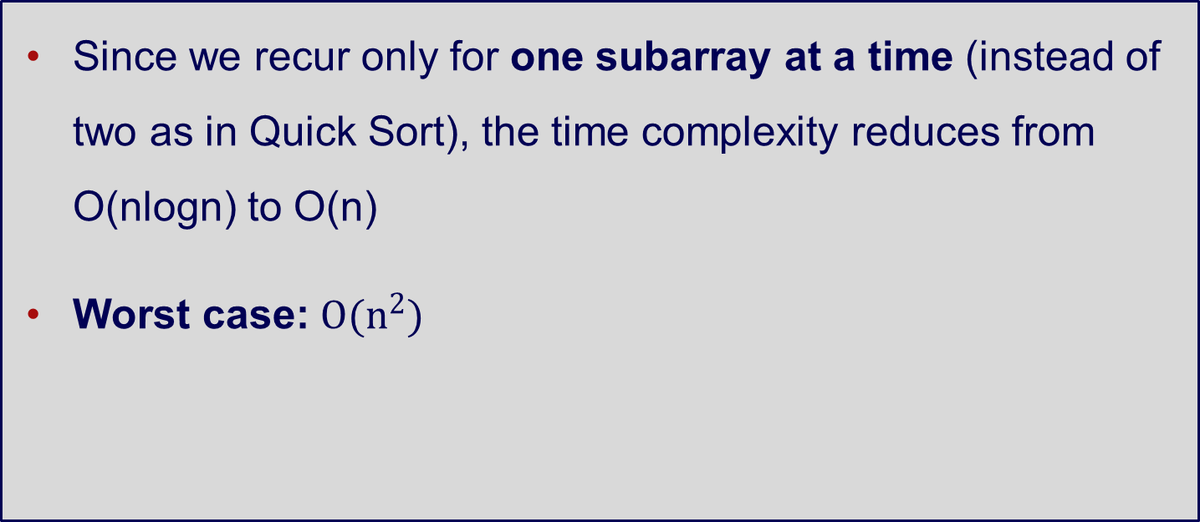
Quick Select – Analysis
Since we recur only for one subarray at a time (instead of two as in Quick Sort), the time complexity reduces from O(nlogn) to O(n)
Worst case: $O(n^{2})$

Slide 69
Quick Sort – Reminder
https://en.wikipedia.org/wiki/Quicksort

Slide 70
Extra topic: K-dimensional tree (K-d tree)

Slide 71
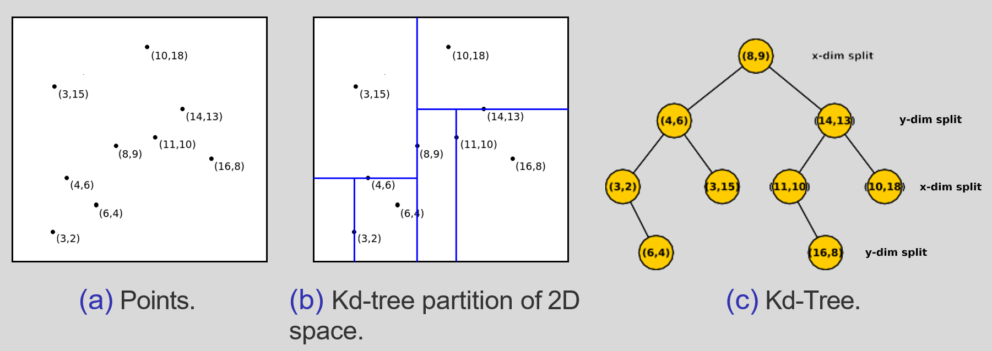
K-d tree
K-dimensional tree (K-d tree) is a binary tree, specifically designed for spatial based indexing.

Slide 72
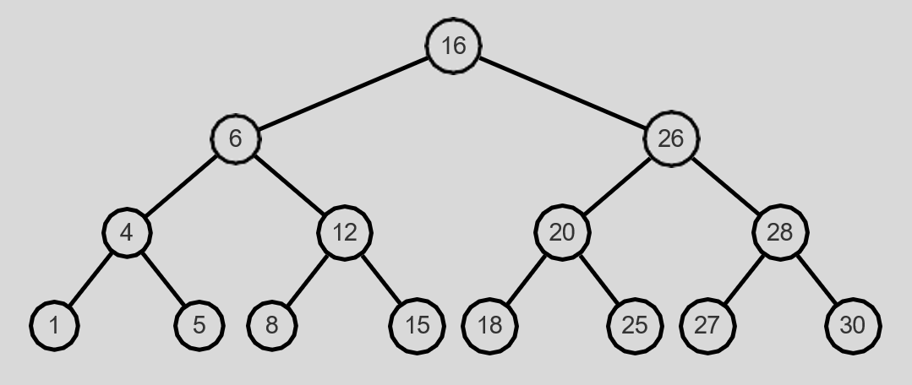
Balanced K-d tree
Example of a balanced, full binary search tree

Slide 73
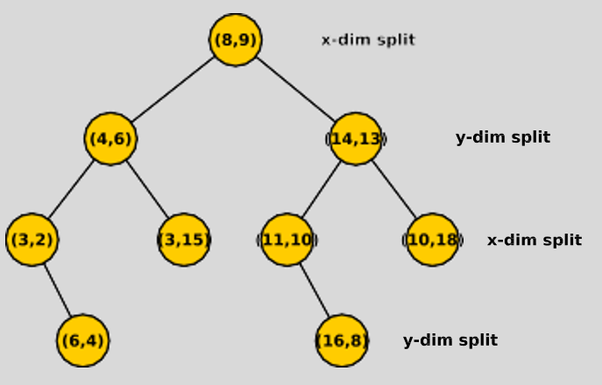
K-d tree
Organised similarly to BST, left subtree less than parent node, right subtree greater than.
What about the two or more dimensions?
Each level, split by x or y dimensions (for 2D)
For a node, if split on x-dimension, its left subtree has x-dim values less than it, its right subtree has x-dim values greater
Similarly for a node split on y-dimension (determine on y-dim values)
Splitting dimension alternate

Slide 74
K-d tree construction
Set of points given at start, need to construct tree. We aim to have build tree according to properties, but aim to have tree balanced.
Pick a dimension to initially split on (e.g., x-dim)
Order points in x-dim, and choose median point - this forms our root node.
Partition rest of points according to those having x-values less than root, and those greater than root.
For each partition, go back to step 2, but now split on y-dim. For each selected as median in the two partitions, they form the left and right children.
Repeat alternating split dimension until remaining partitions are empty or contain one point - these singleton point partitions form the leaves. Empty partitions we don’t need to do anything.

Slide 75
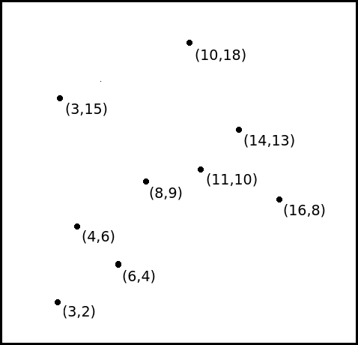
K-d tree construction
Initial set of points:

Slide 76
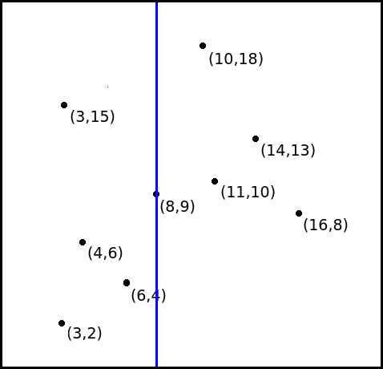
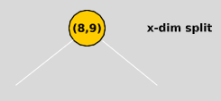
K-d tree construction

Slide 77
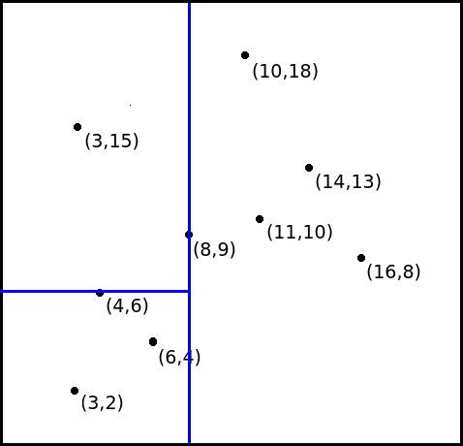
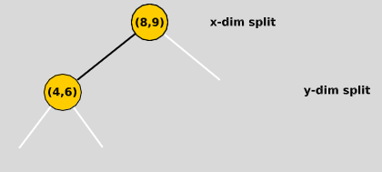
K-d tree construction

Slide 78
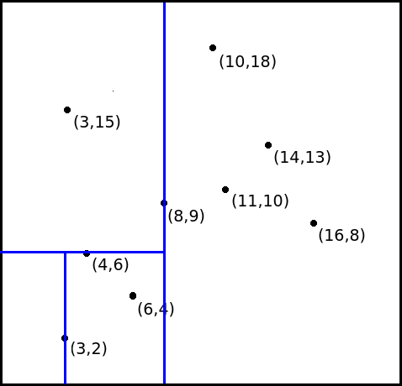
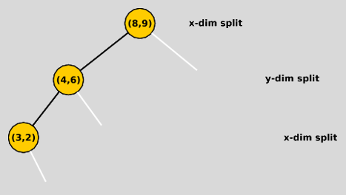
K-d tree construction

Slide 79
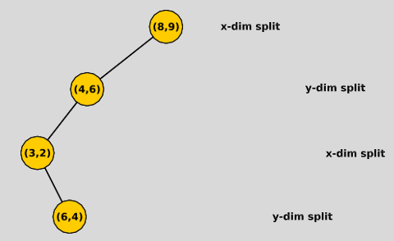
K-d tree construction

Slide 80
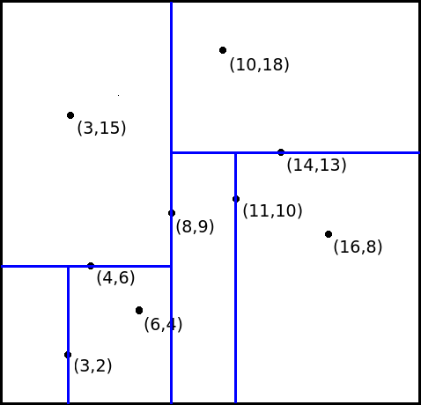
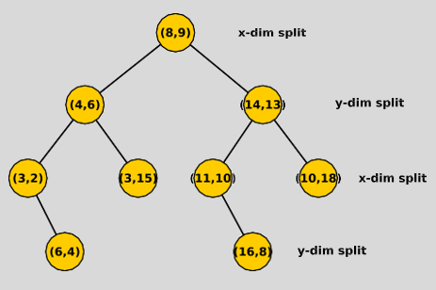
K-d tree construction

Slide 81
K-d tree search (nearest neighbor query)
Given a query, we wish to find which point is closest to it:
Start at the root node
Move down the tree recursively, going left or right depending on the current visited node, which dimension it is splitting, and the query point
When reach a leaf node (or there is an empty subtree in the direction we want to go), we stop the recursion and save that node as the current closest point to the query
Unwind back the recursion. Looking to see if there is a closer point
When reach the root node, we do the same checks as before (see if root closer, check if we need to go down the other side). Once these are done, we are finished and the current closest point is the nearest neighbour to the query

Slide 82
Search for nearest neighbour How to unwind
We basically re-track up to the path of the root node. While re-tracking, we do two things:
Check the current node to see whether it is closer to the query than the current closest point
Check if the other subtree/partition can potentially have a closer point
Calculate the distance between the points to determine the nearest neighbour

Slide 83
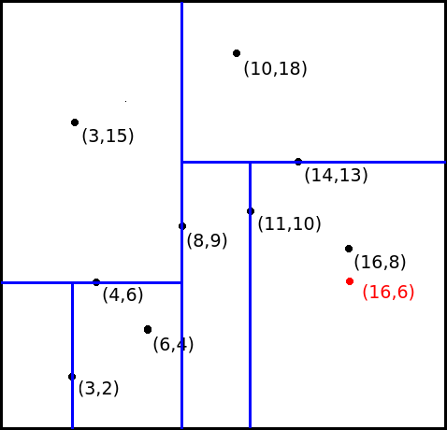
Search for the nearest neighbour

Slide 84
Search for the nearest neighbour
d((16,6),(16,8)) = 2
d((16,6),(11,10)) = 11
d((16,6),(16,8)) < d((16,6),(11,10))
(16,8) is the current closest point
Now we need to check if the other subtree of (11,10) can potentially have a closer point
(16,6)

Slide 85
Search for the nearest neighbour
Now we need to check if the other subtree of (11,10) can potentially have a closer point
Check straight line distance to partitioning line → (11,6)
d((16,6),(11,6)) = 5
d((16,6),(16,8)) = 2
(16,8) is still the nearest neighbour
Continue all the way to the root (8,9)
(11,6)

Slide 86
Search for the k nearest neighbours
That’s the process to search for the one nearest neighbour
What about searching for k nearest neighbours?
We keep k closest points (instead of one)
Only eliminate a sub-tree branch if none of points in that branch cannot be closer than any of the current k closest points

Slide 87
K-d tree adding
Similar to BST and Kd-tree construction
To add a new node X to existing Kd-tree:
Traverse tree
When read empty node, insert node and make necessary connection to predecessor

Slide 88
K-d tree deletion
To delete point p from existing K-d tree (note: this approach is not the most efficient one):
Traverse tree to find node where p is. Call this node Y
Delete Y
For all nodes in subtree of Y, use construction method to recreate subtree, rooted at former position of node Y

Slide 89
Why are we studying K-d tree?
To solve the nearest neighbours problem
Can’t we use graph search (e.g., BFS)?
Think about when you are searching in a 3D space

Slide 90
Wrapping things up

Slide 91
Learning objectives
Understand the Decrease & Conquer approach
Understand and apply:
Decrease-by-a-constant algorithms (Insertion Sort and Topological Sort)
Decrease-by-a-constant-factor algorithms (Binary Search and Fake Coin problem)
Variable-size decrease algorithms (Interpolation Search and Quick Select)

